Slide 1
Arthog 2025

Slide 2
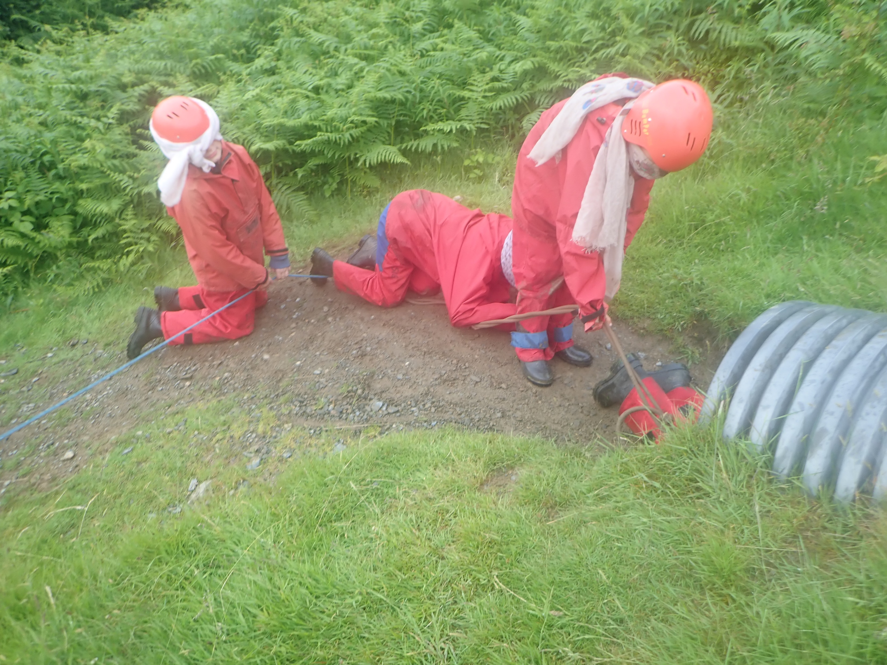
What will the children be doing?
The nightline
The nightwalk
Canoeing or kayaking
Climbing
Team games
Gorgewalking

Slide 3
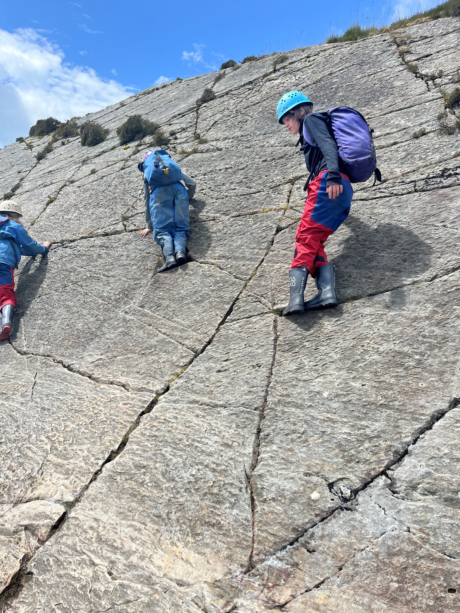

Slide 4
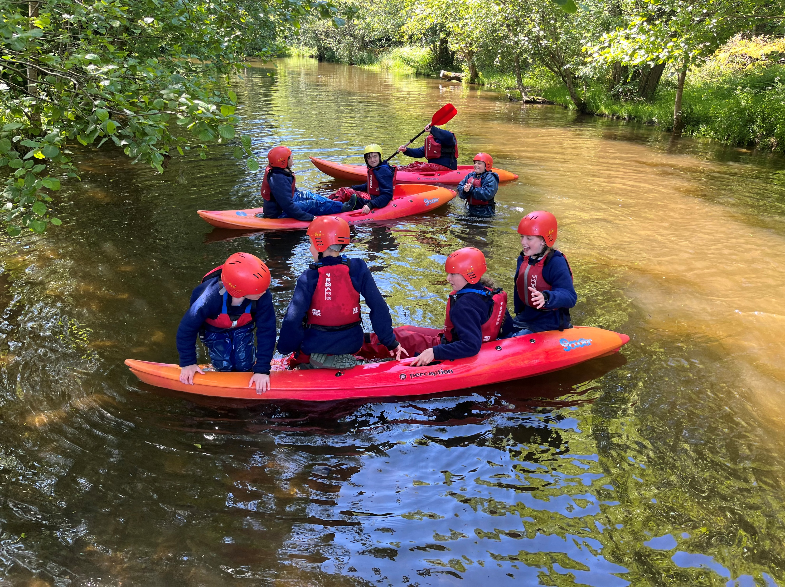

Slide 5
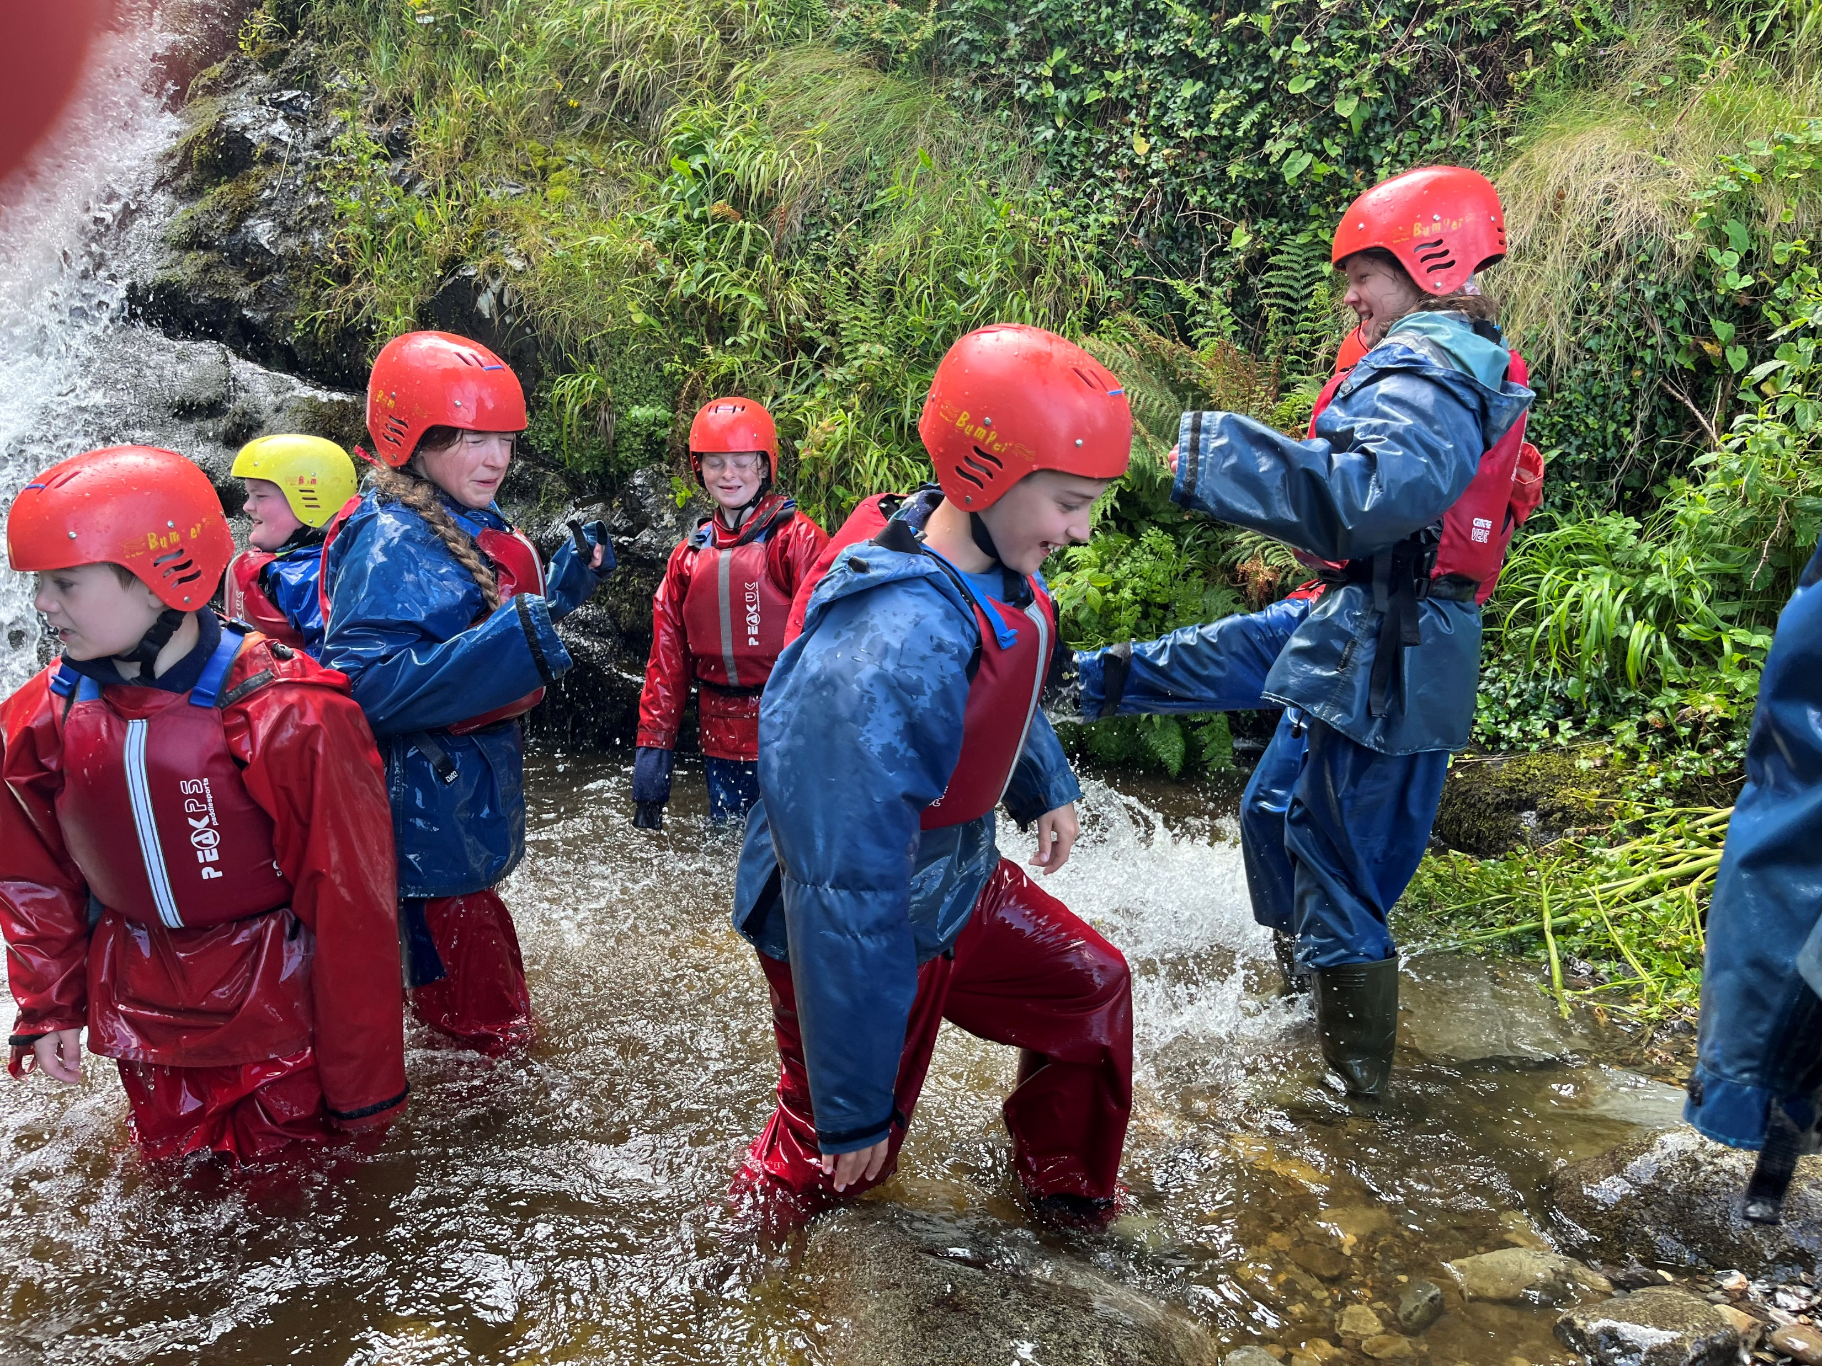

Slide 6
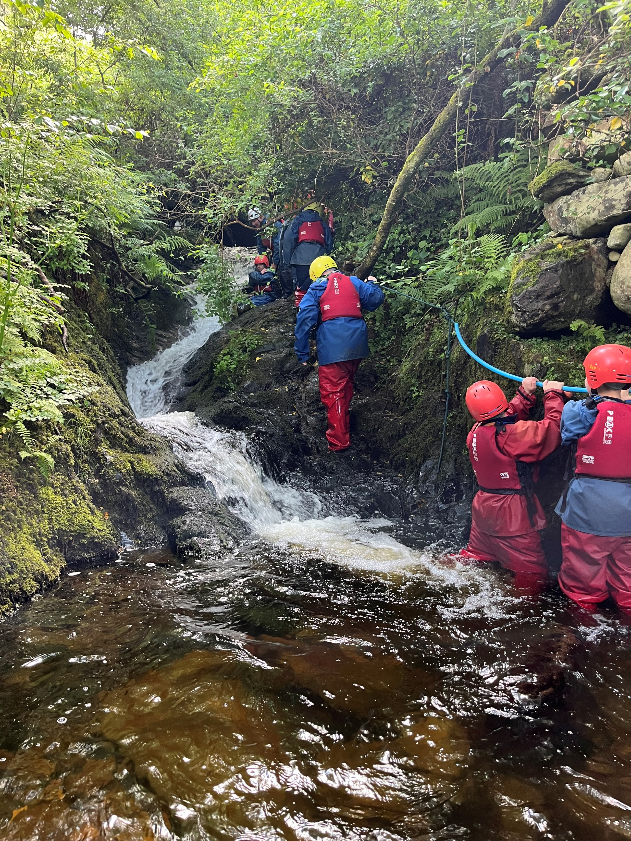

Slide 7
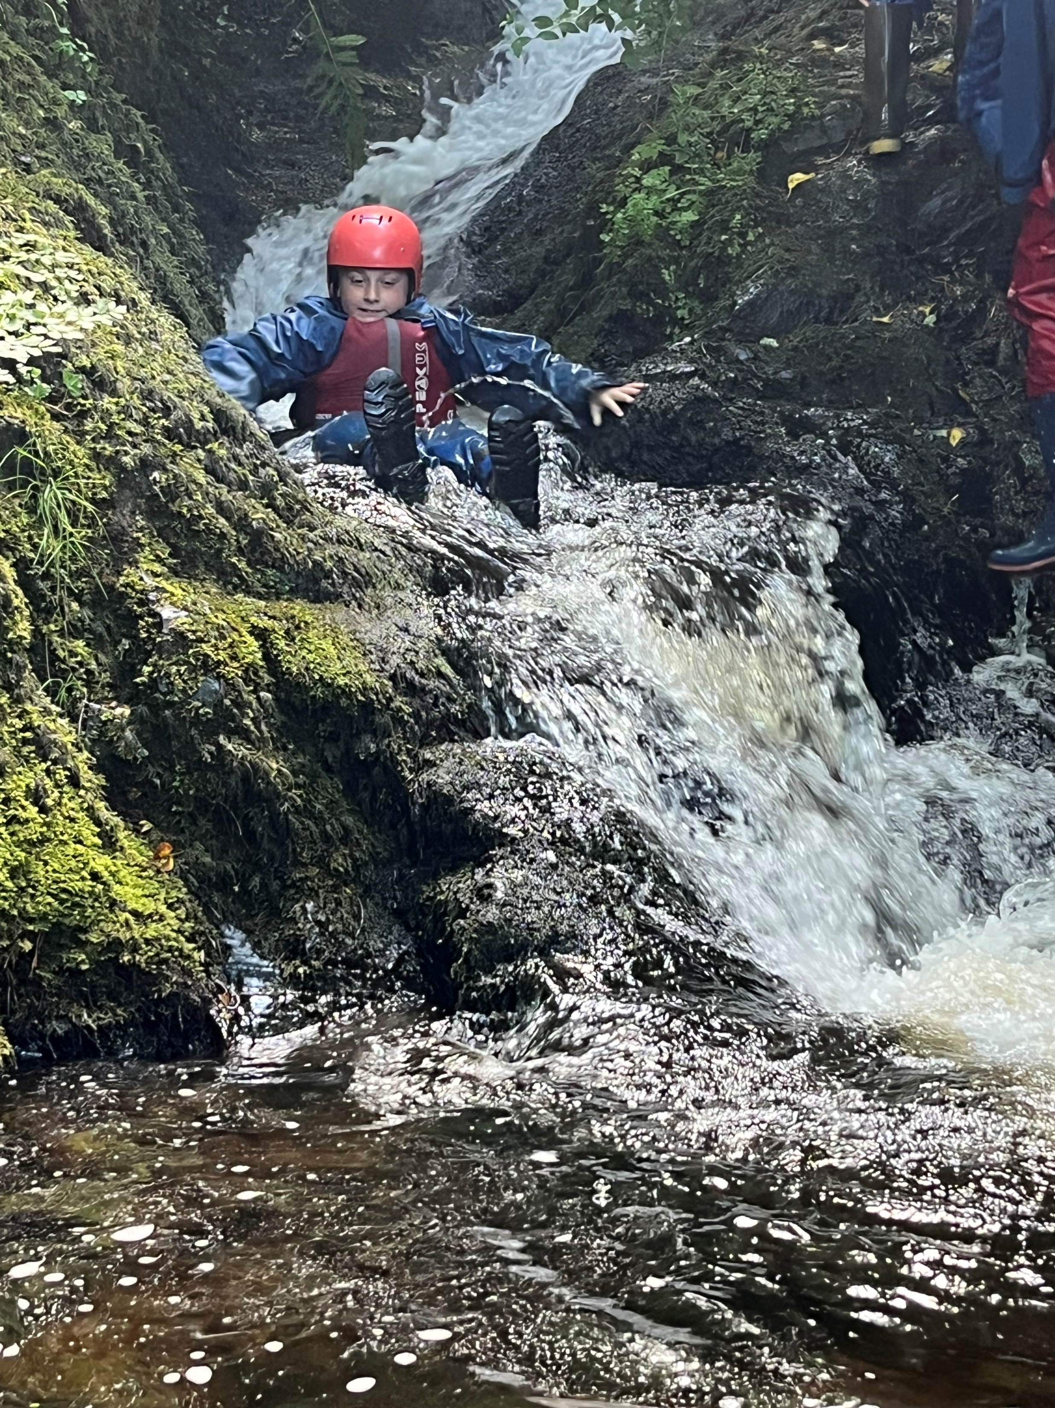

Slide 8
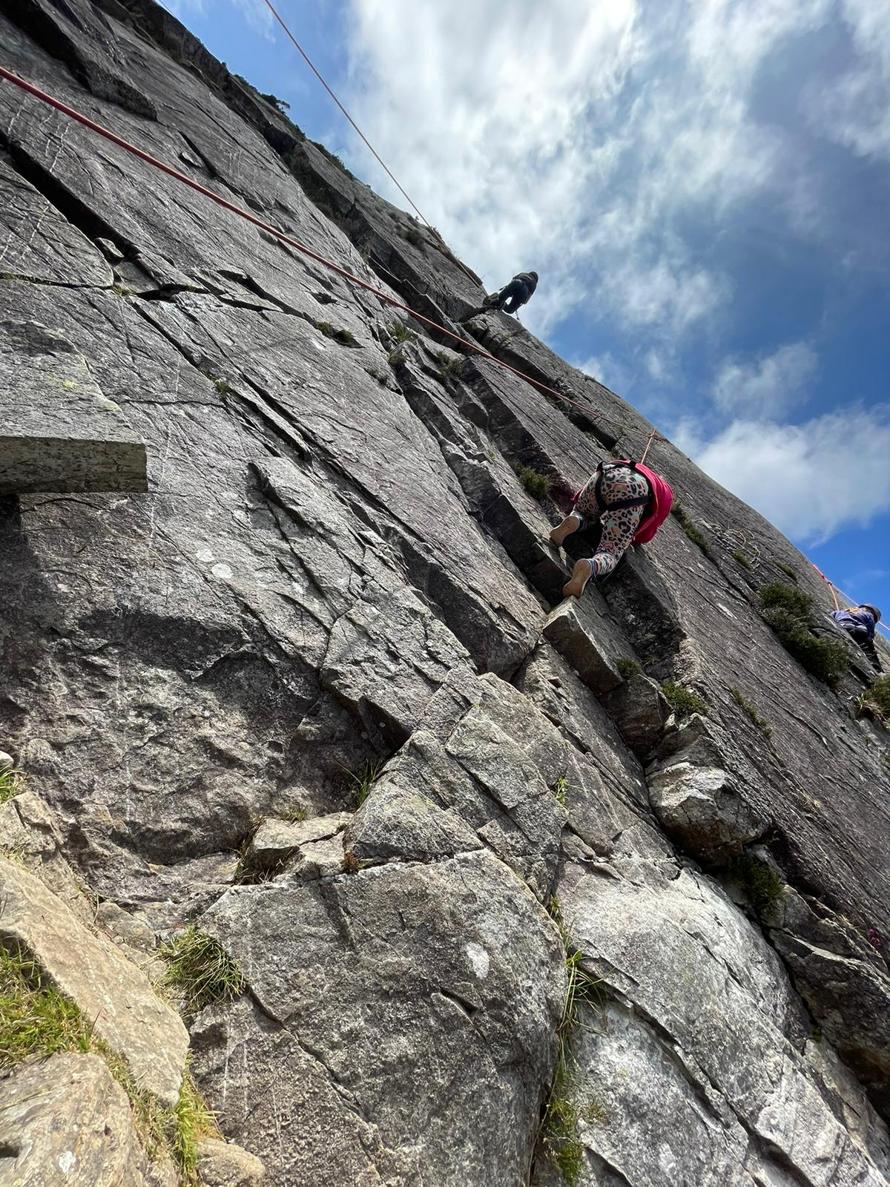

Slide 9
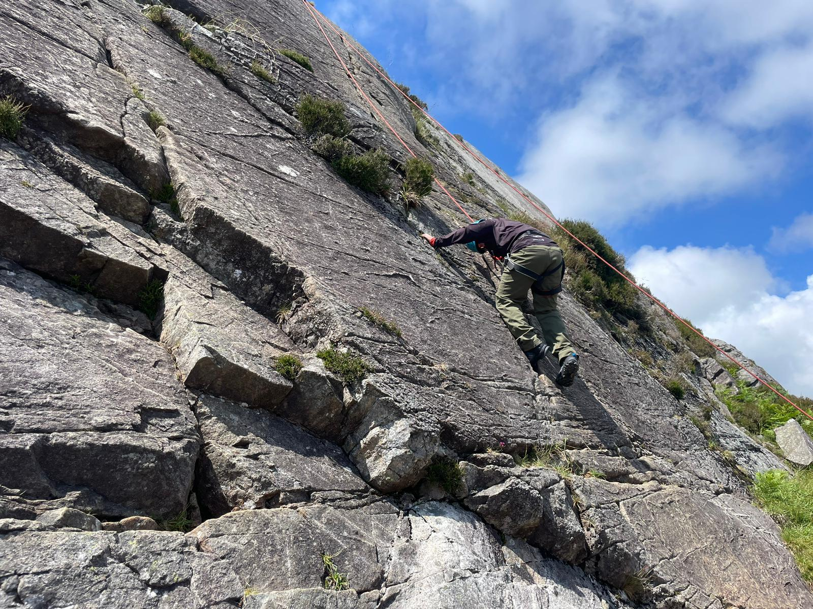

Slide 10
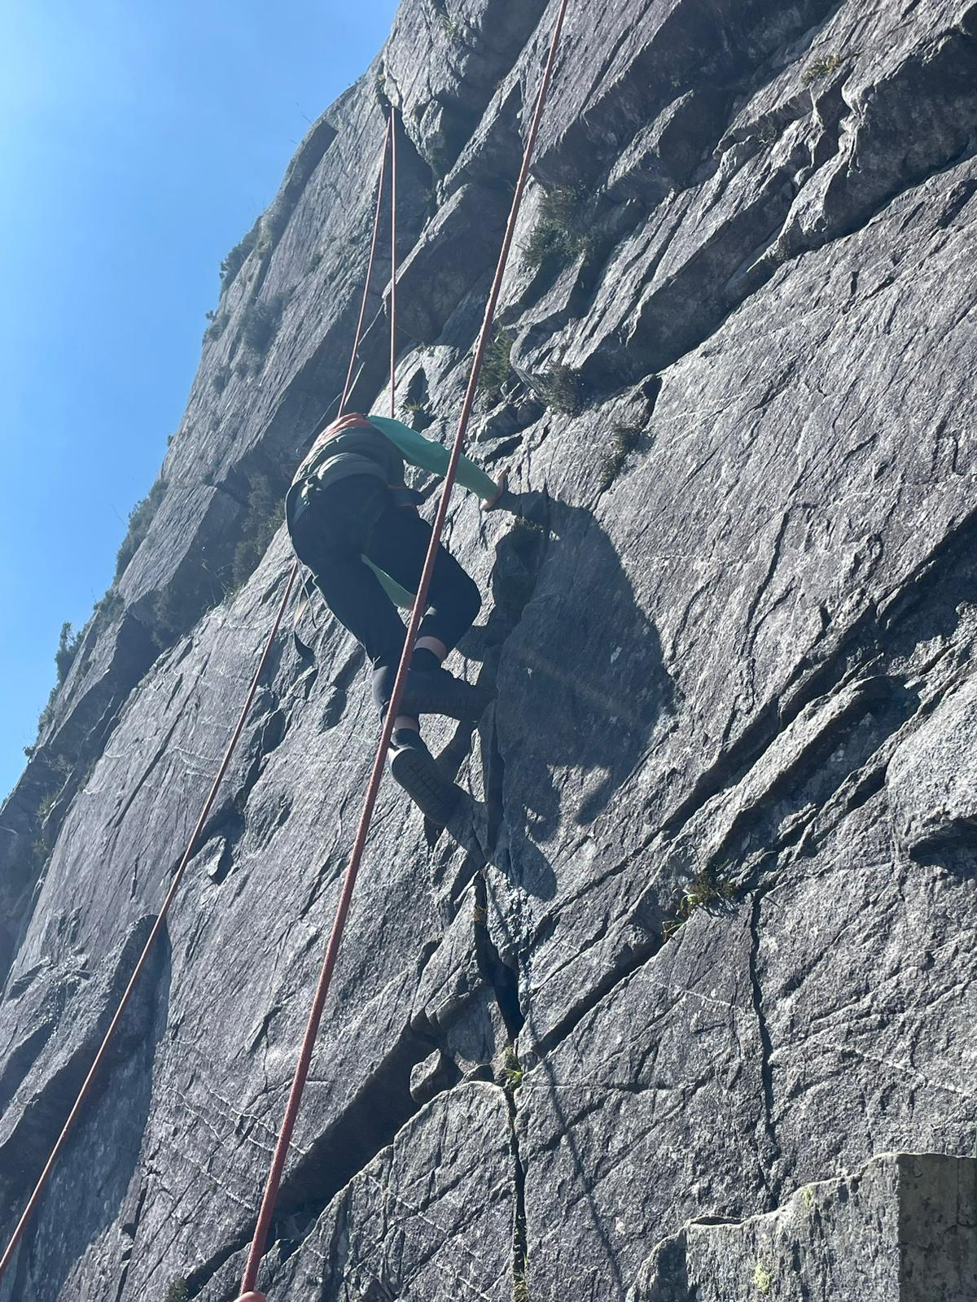

Slide 11
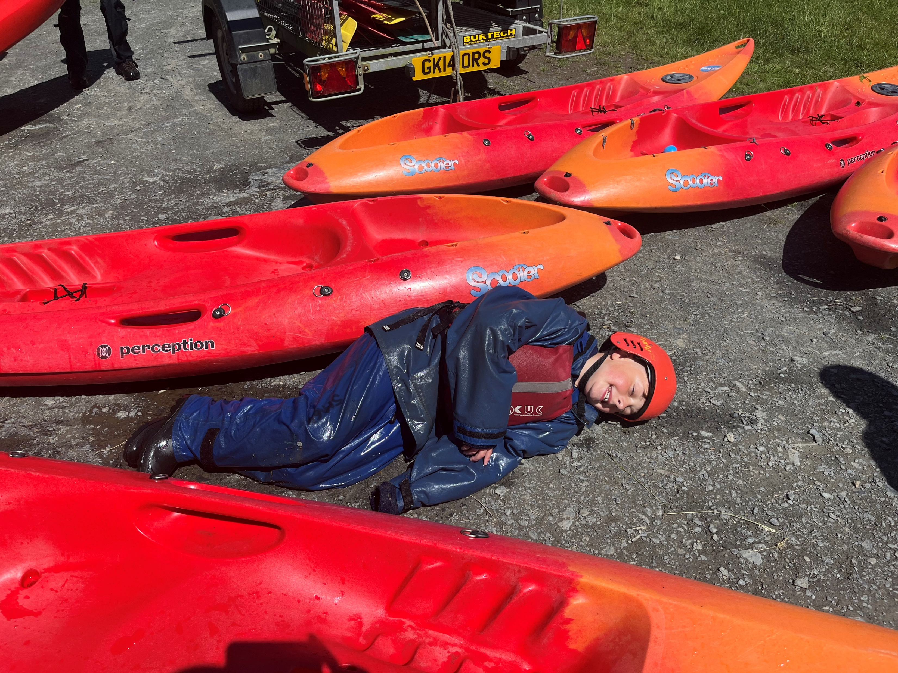

Slide 12
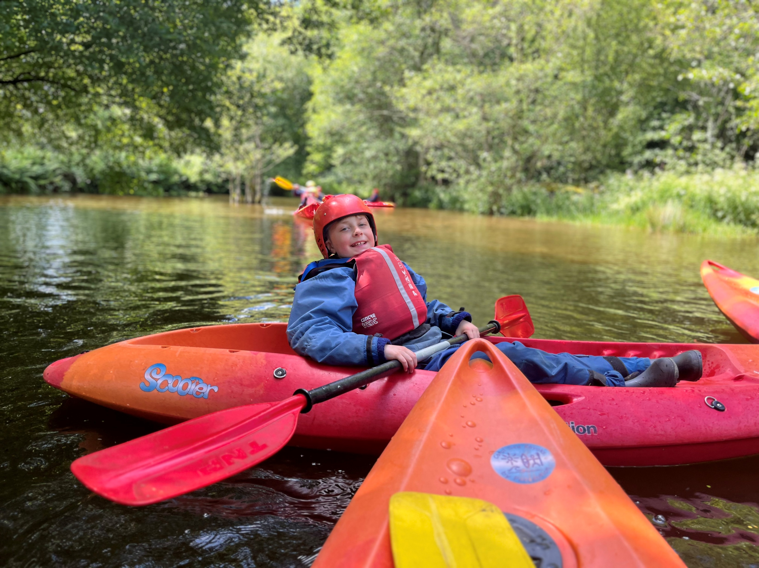

Slide 13
Arthog in winter is great fun but children must be prepared. It can get very cold.
They need to have plenty of clothes
When it is cold, children need to wear layers.
Pack plenty of t shirts, and fleeces.
Don’t pack 2 fleeces thinking one will stay dry. Pack 4.
Pack plastic bags for wet clothes.
Pack spare hats and spare gloves – wet gloves will not dry there quickly enough.
Arthog will provide good waterproof kit, good boots and rucksacks.
Pack wellies, but if you don’t have them, there are plenty there.
Notes:
Arthog in winter is great fun but children must be prepared. It can get very cold.
They need to have plenty of clothes
When it is cold, children need to wear layers, which we will advise them to do, and we will check.
Pack plenty of t shirts, and fleeces. Jumpers and fleeces can get very wet. If the child only has two, and the second gets wet, they won’t have a dry one for their next activity.
Many activities are wet. They will be encouraged to wear dirty dry clothing again but wet clothing simply will not be dry during the length of our stay.
Pack plastic bags for wet clothes.
Pack spare hats and spare gloves – wet gloves will not dry.
Arthog will provide good waterproof kit, good boots and rucksacks.
Bring wellies, but if you don’t have them, there are plenty there.

Slide 14



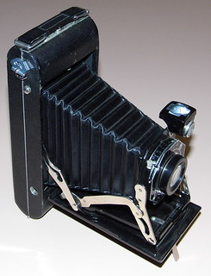
Do not pack:
phones
tablets
cameras
or any other electronics.

Slide 15
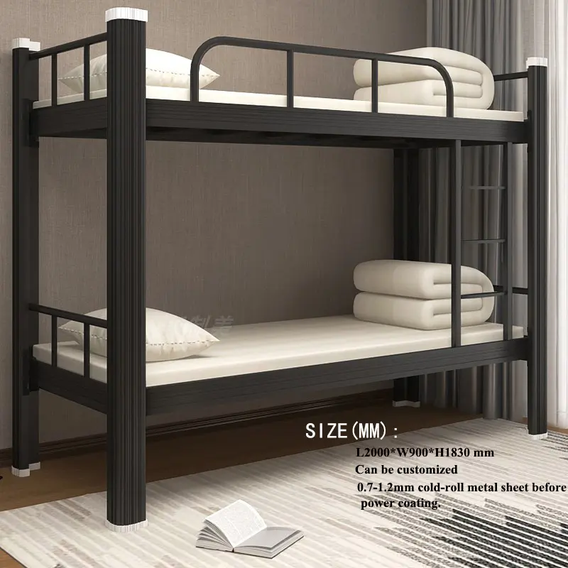
Please make sure your child knows how to put on a duvet, sheet and pillow slip.
Not Arthog bunk beds!
Notes:
We do help them, but there are only 4 adults! We encourage children to help each other but it helps if each child knows how bedding works.
Mrs Mavin and I have sorted out which rooms the children are in. We tell them when they get there. The children will be in three groups for their activities. Everyone has at least one good friend in their group. Arthog is about making new friendships and we encourage children to socialise out of their comfort zone.

Slide 16
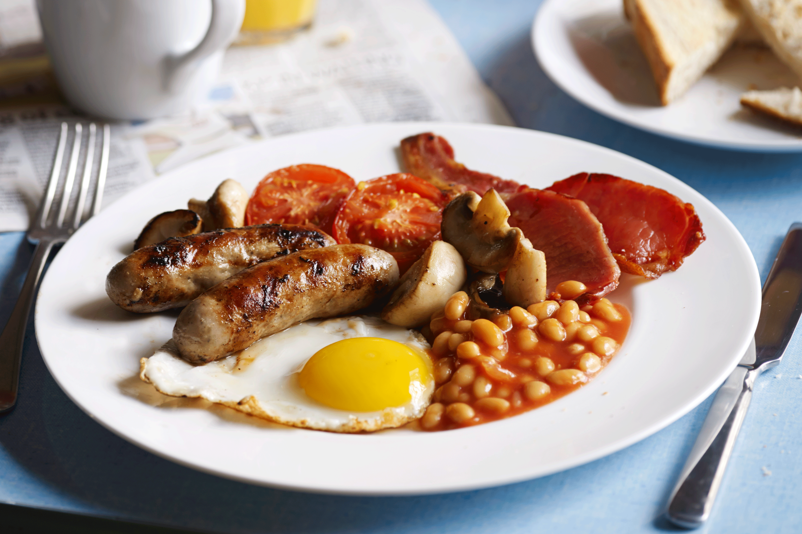
There is plenty to eat.
Breakfast and dinner will be had at Arthog.
Lunches are collected from the kitchen and either eaten at the activity or in the children’s common room.
If there is a food allergy we are not aware of, or if your child will not eat certain things, please tell us before we go.
Notes:
Give details of lunches.

Slide 17
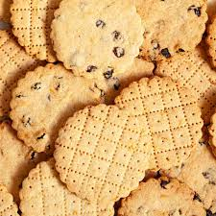
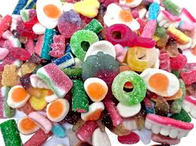
Sweets and biscuits
Please do not feel the need to send these.
The children get plenty to eat.
If you are sending some, then a single pack is sufficient.

Slide 18


No sprays please.
They set off the smoke detectors.
Send roll ons.

Slide 19
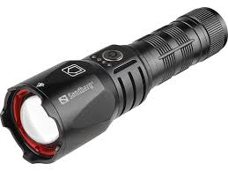
Please pack a torch.
Notes:
It’s not mentioned on the kit list but please send a torch. If we do the night walk, some sections of the walk are very dark.

Slide 20

Medical
Asthma – please pack a new reliever and their spacer in your child’s rucksack so they know where it is, and pack any steroid inhalers in their bag. (If your child has an inhaler in school they can bring this)
All medicines, including travel sickness tablets, will need a completed medical form.
Notes:
Discuss first aid arrangements.

Slide 21
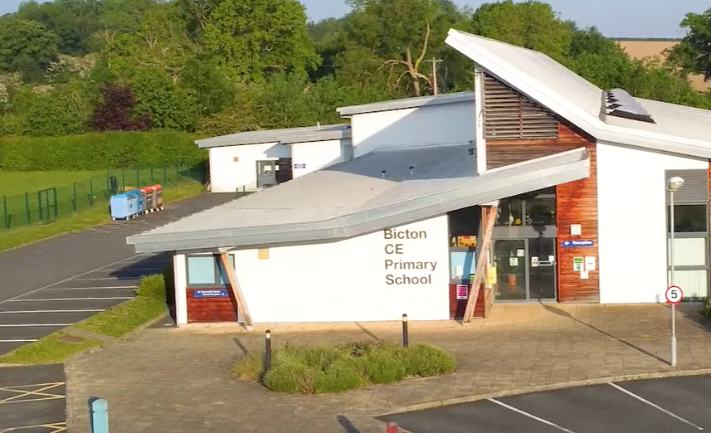
For the first day,
Children will need a rucksack in which they will have:
a leakproof water bottle
a packed lunch
a coat
a book or card game for the journey
hat and gloves.
(inhaler and spacer)
Leave their bags here to put on the coach.
Notes:
NO SWEETS on the coach – it’s a recipe for disaster.
Departure time on Wednesday – 9:15 to 9:30
Arrival back at Bicton 6 pm This may change so please make sure that you check on messages via Class Dojo or the school website. Be prepared for us being back ½ hour early or ½ hour late. If weather conditions change, we will let you know if it changes the ETA.

