Slide 1
Mark Making
Mark making as a visual language

Slide 2
Visual Recording
Today we are going to be exploring different ways you can make marks in your art work.
Take a look at some of the ideas I have included in this powerpoint and see how they inspire you to make your own!

Slide 3
Ideas…

Slide 4
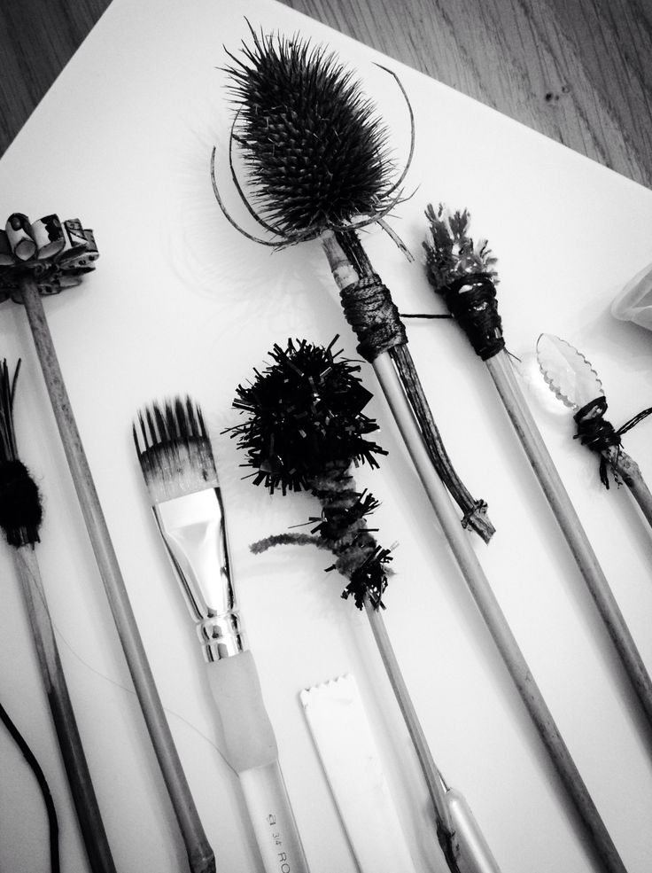
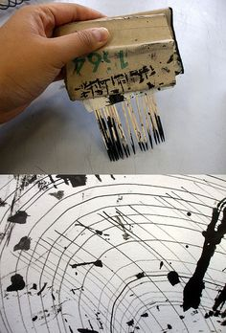

Slide 5
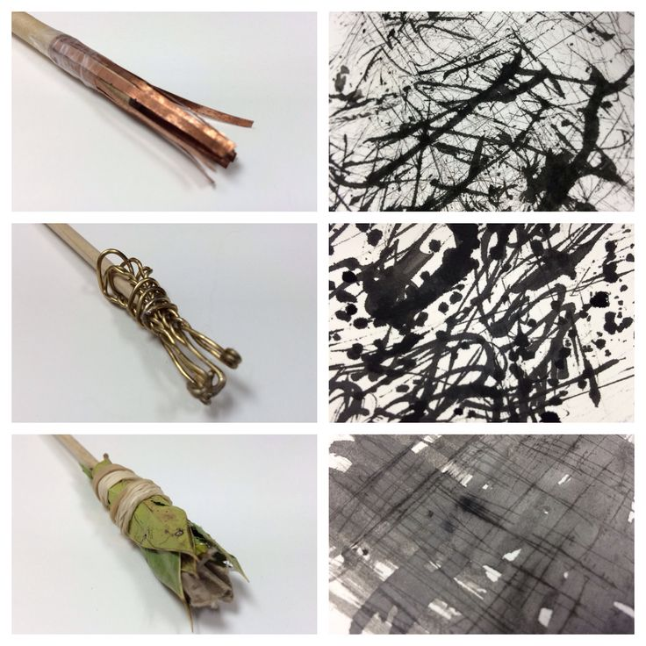
This would make a great ‘technical’ page in your sketchbooks

Slide 6
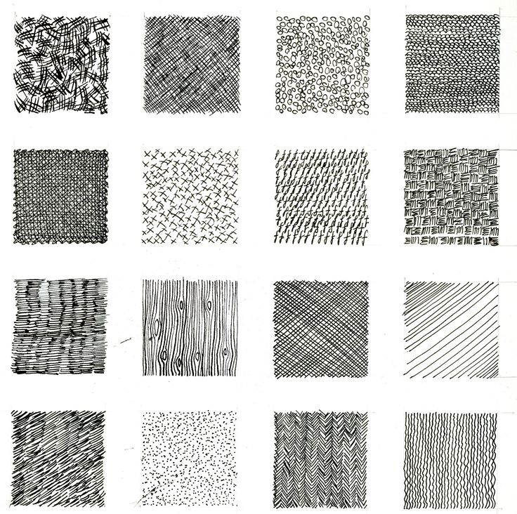

Slide 7
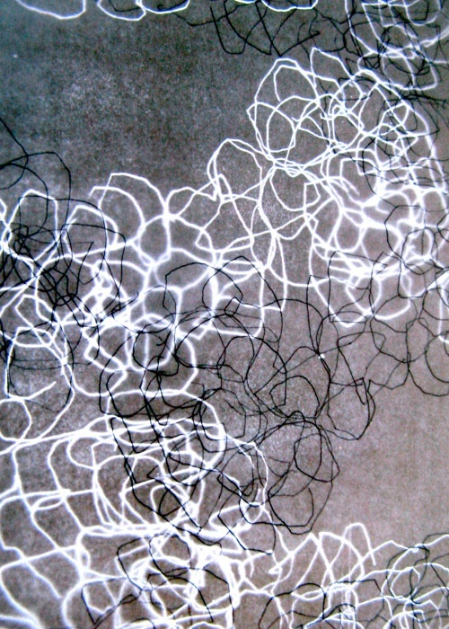

Slide 8
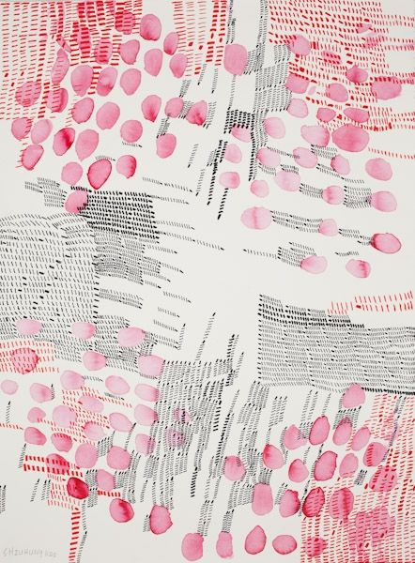

Slide 9
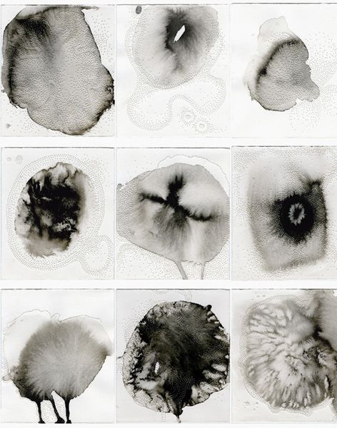

Slide 10
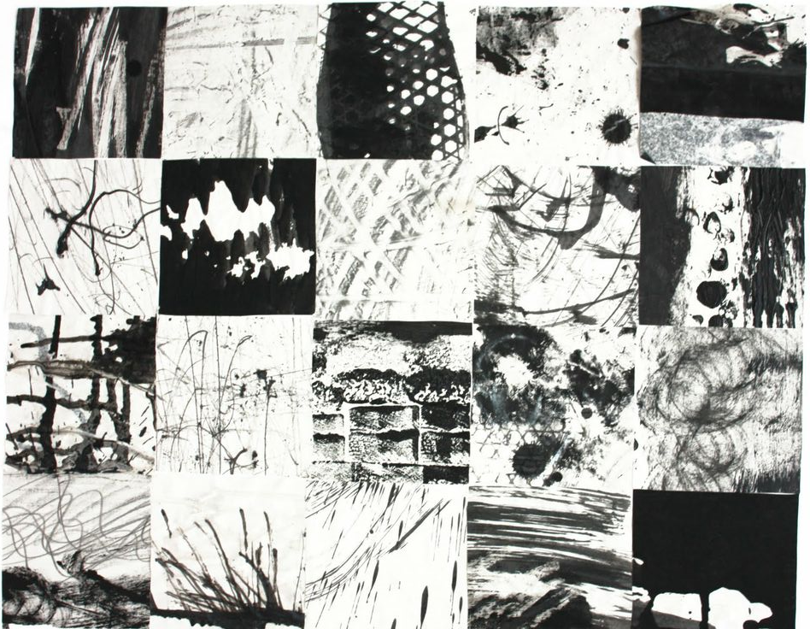

Slide 11
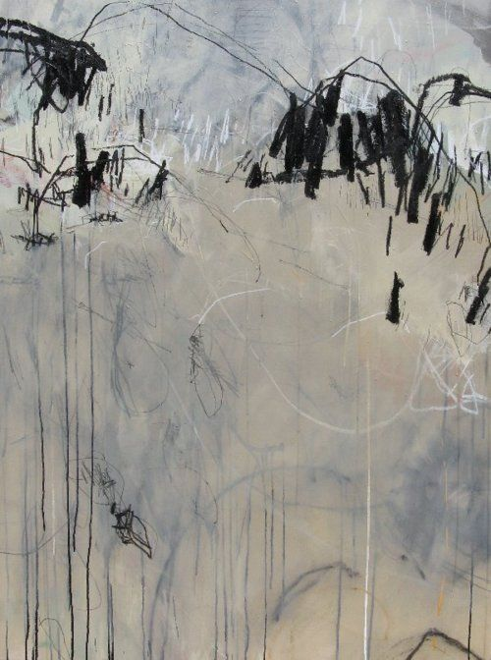

Slide 12
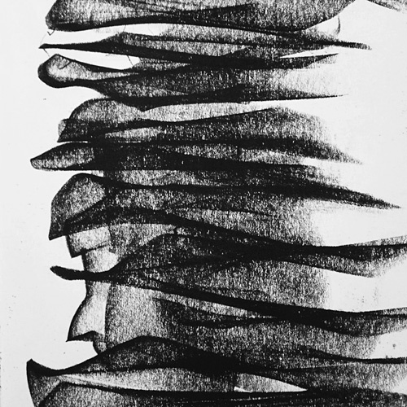

Slide 13
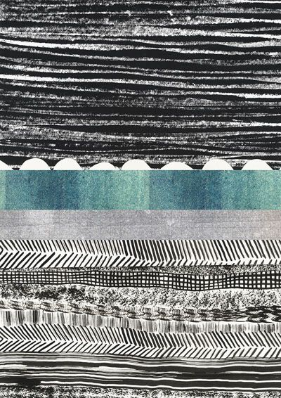

Slide 14
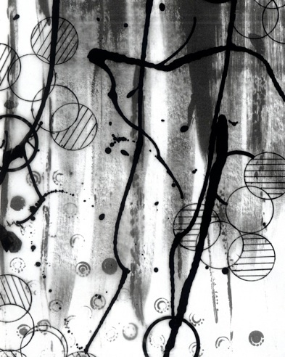

Slide 15
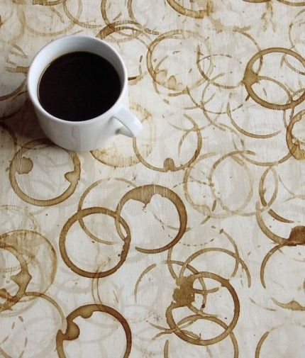

Slide 16
Texture

Slide 17
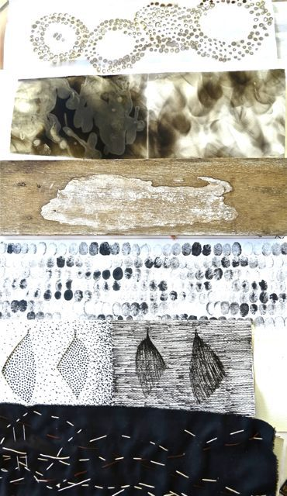

Slide 18
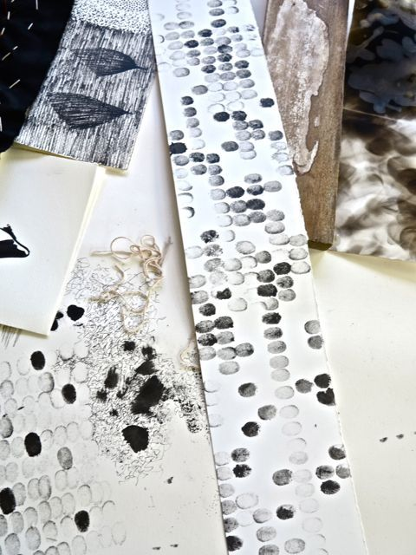

Slide 19
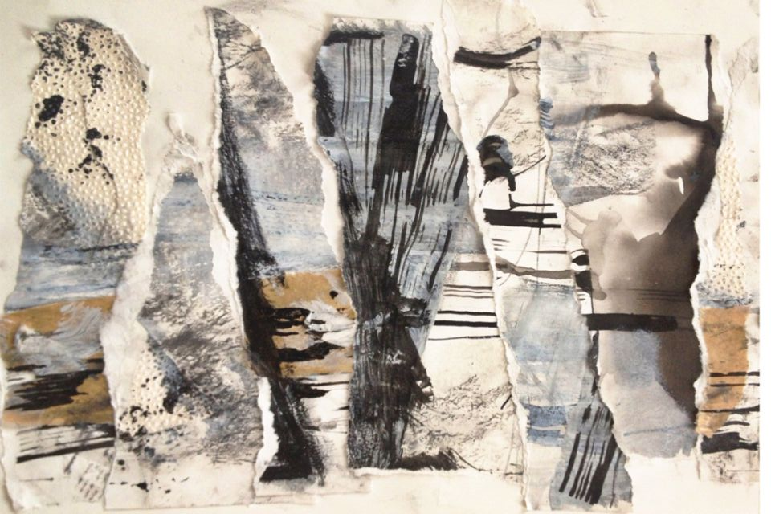

Slide 20
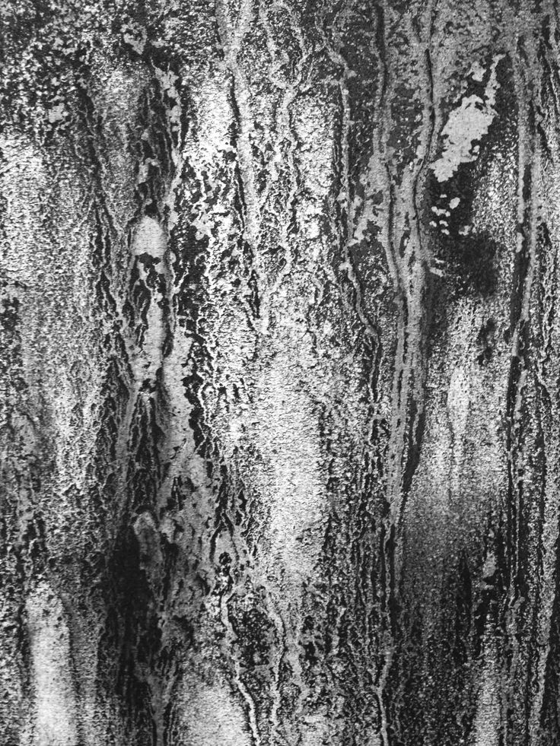

Slide 21
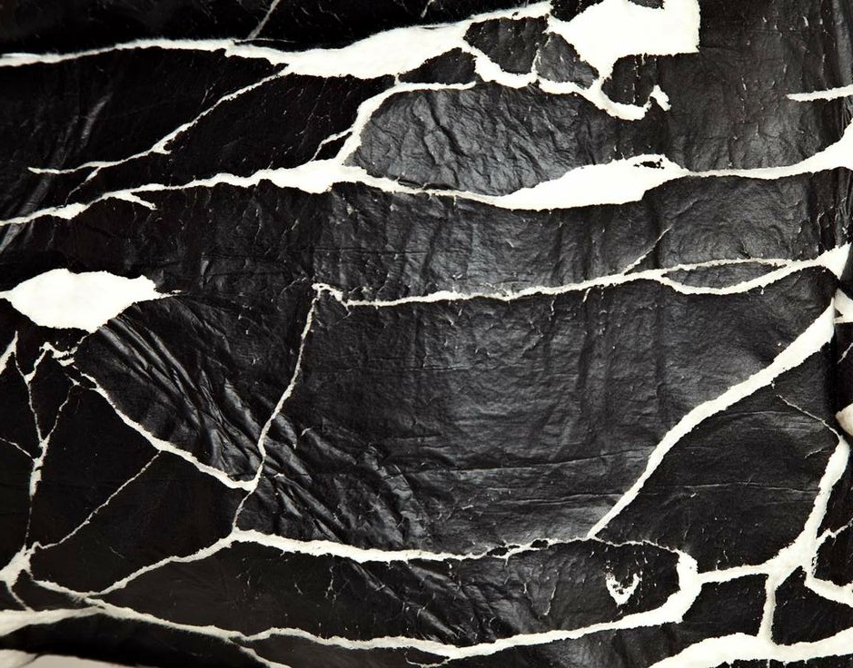

Slide 22
Colour

Slide 23
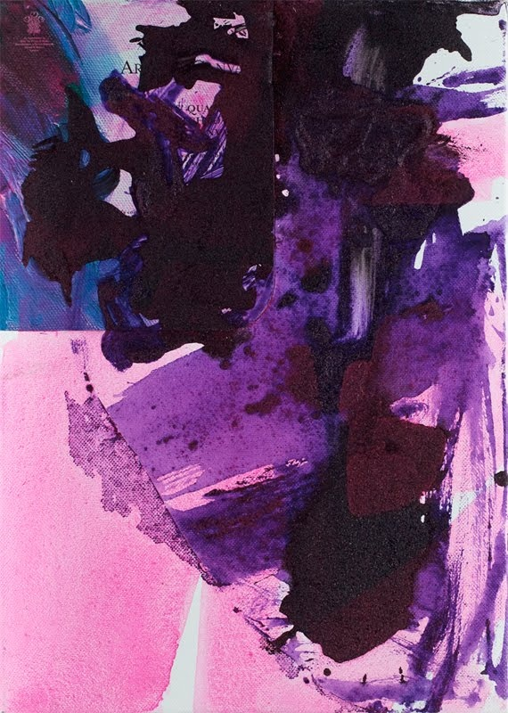

Slide 24
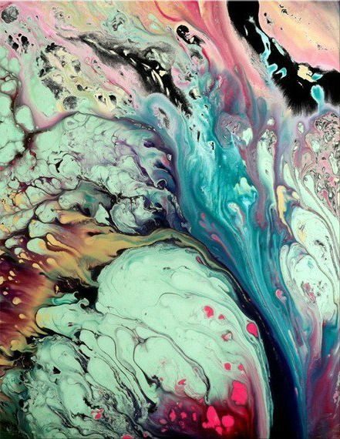

Slide 25
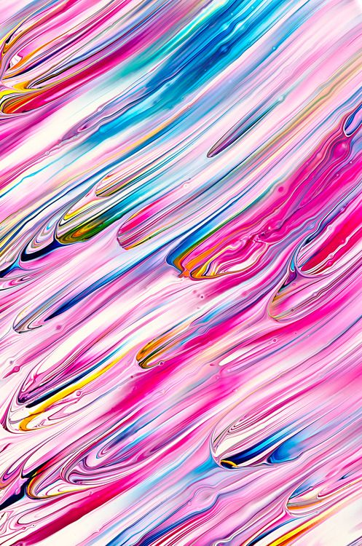

Slide 26
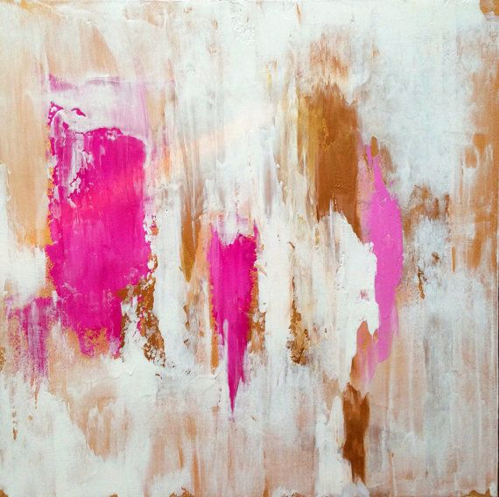

Slide 27
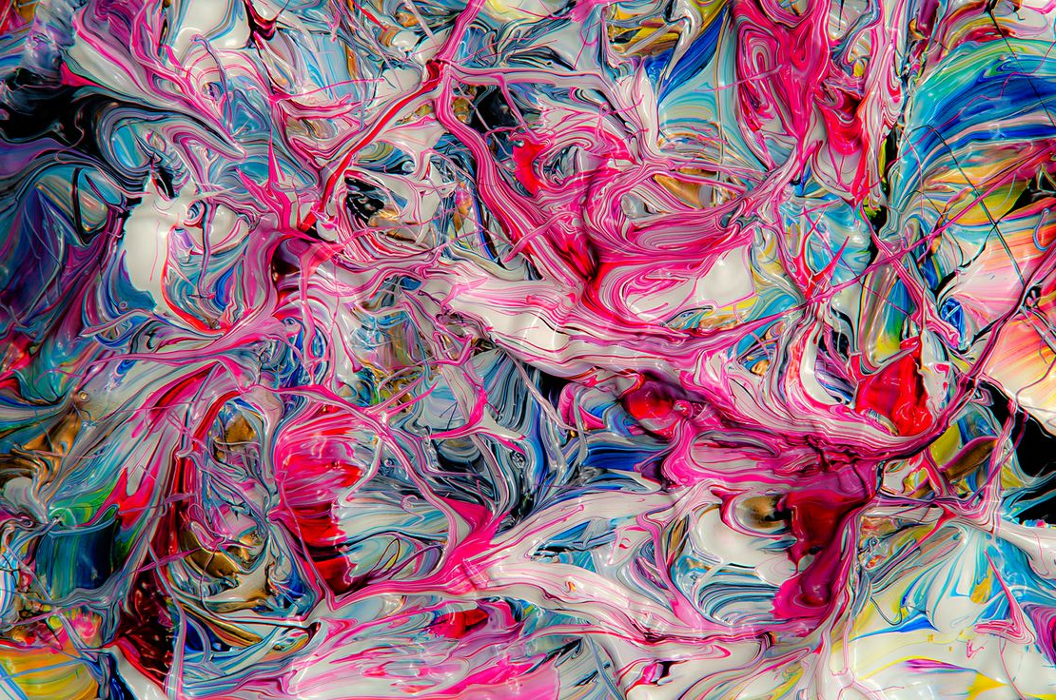

Slide 28
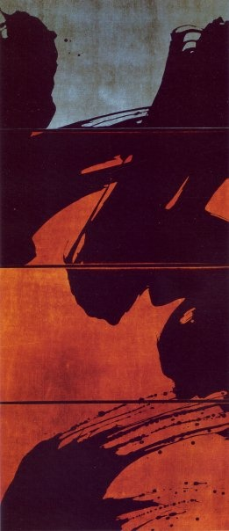

Slide 29
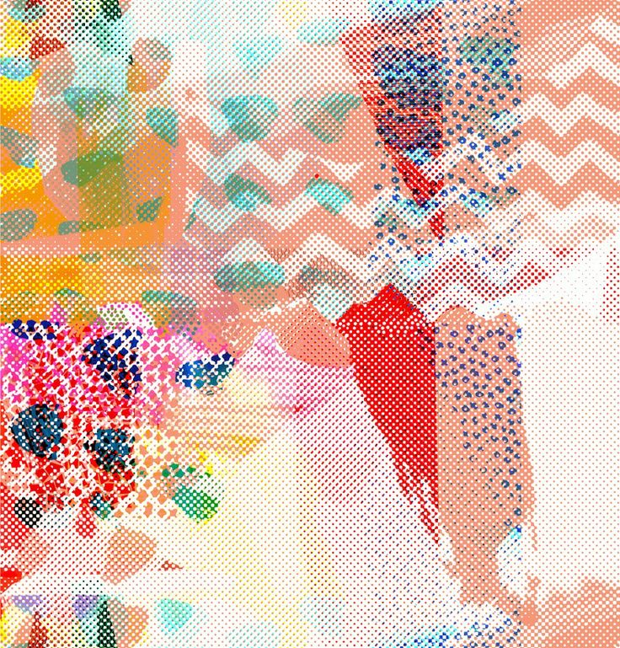

Slide 30
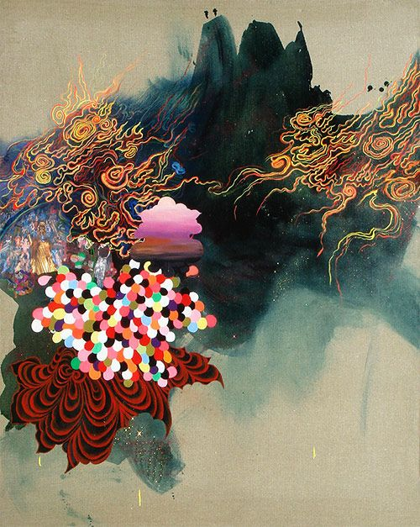

Slide 31
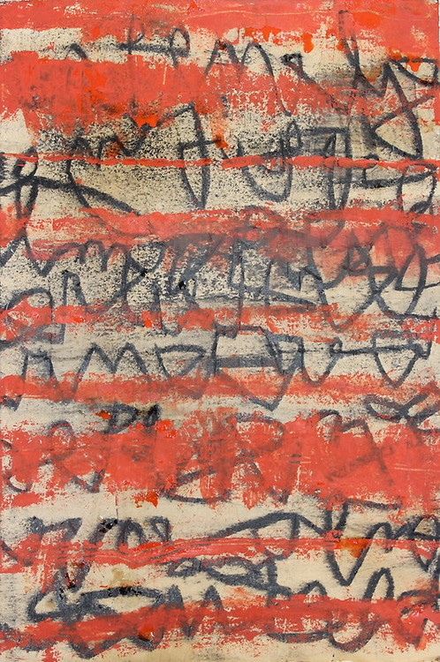

Slide 32
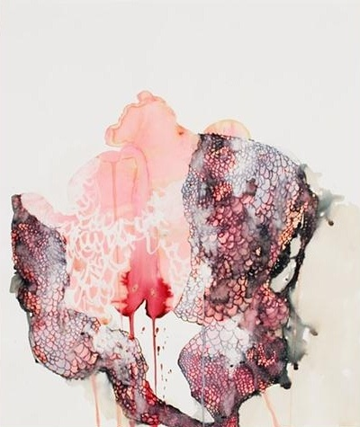

Slide 33
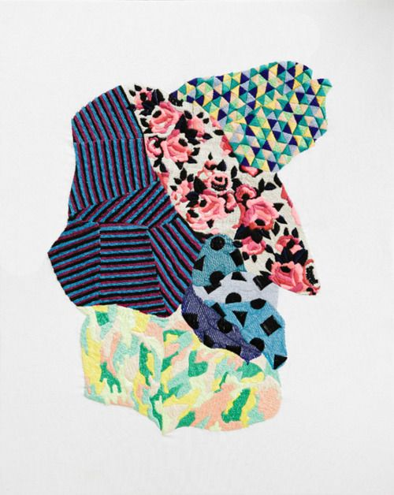

Slide 34
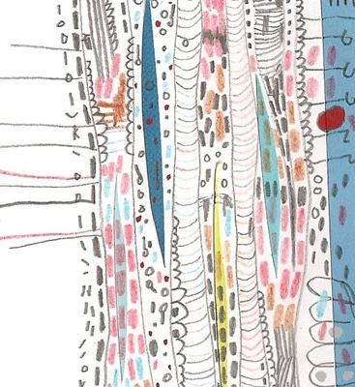

Slide 35
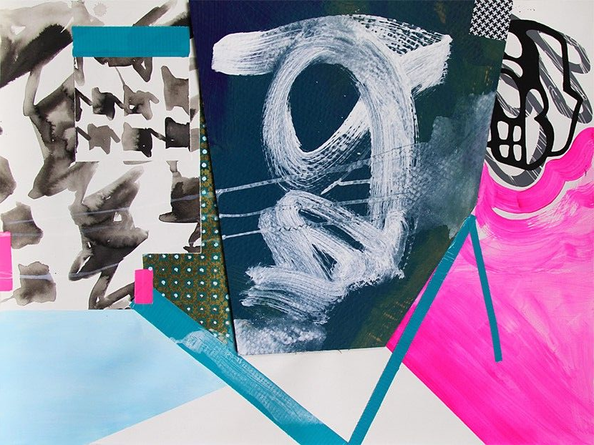

Slide 36
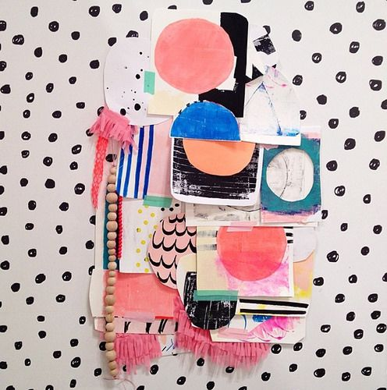

Slide 37
Artists

Slide 38
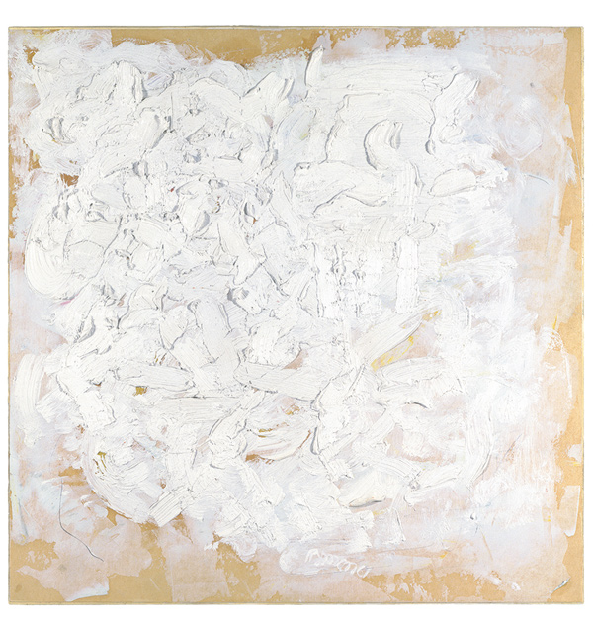
Robert Ryman
Robert Ryman (born May 30, 1930) is an American painter identified with the movements of monochrome painting, minimalism, and conceptual art. He is best known for abstract, white-on-white paintings. The majority of his works feature abstract expressionist-influenced brushwork in white or off-white paint on square canvas or metal surfaces.

Slide 39
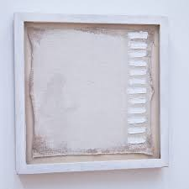

Slide 40
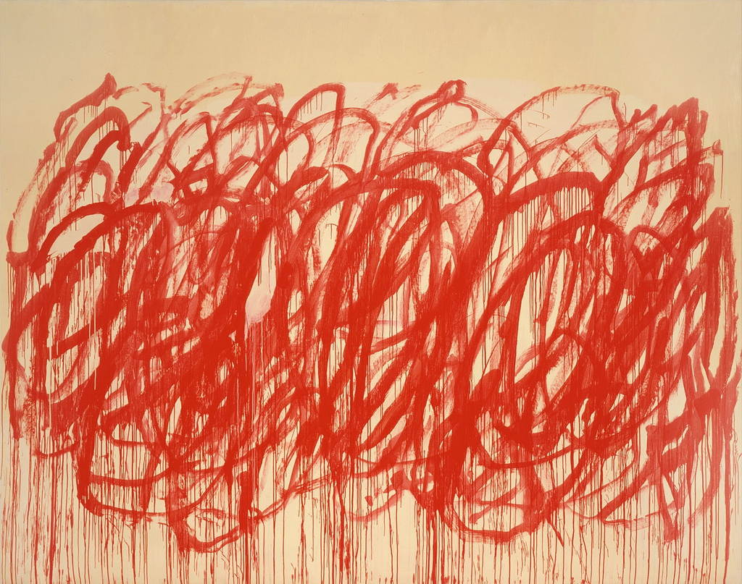
Cy Twombly

Slide 41
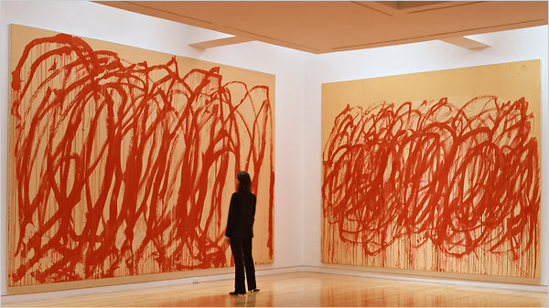

Slide 42
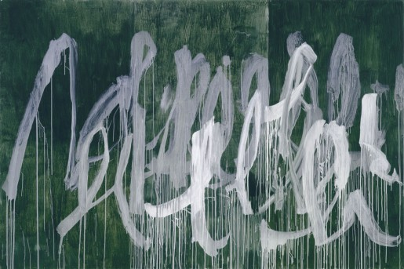

Slide 43
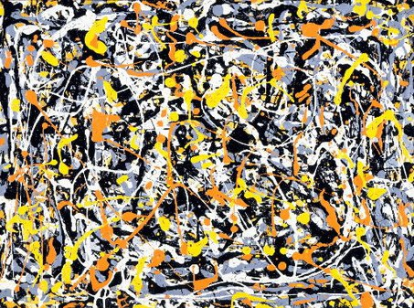
Action painting
Jackson Pollock
Abstract expressionism
Notes:
Abstract expressionism is a post–World War II art movement in American painting, developed in New York in the 1940s.

Slide 44
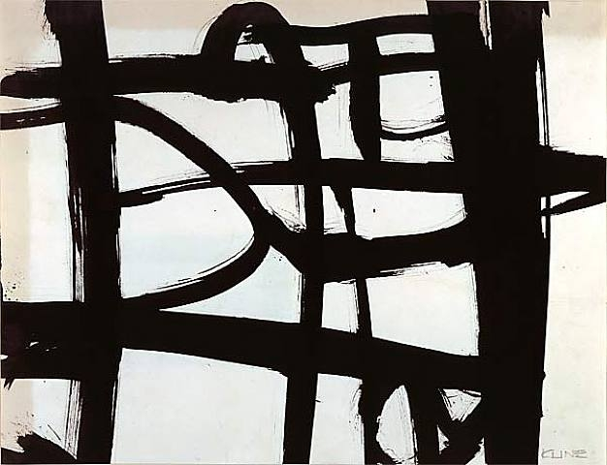
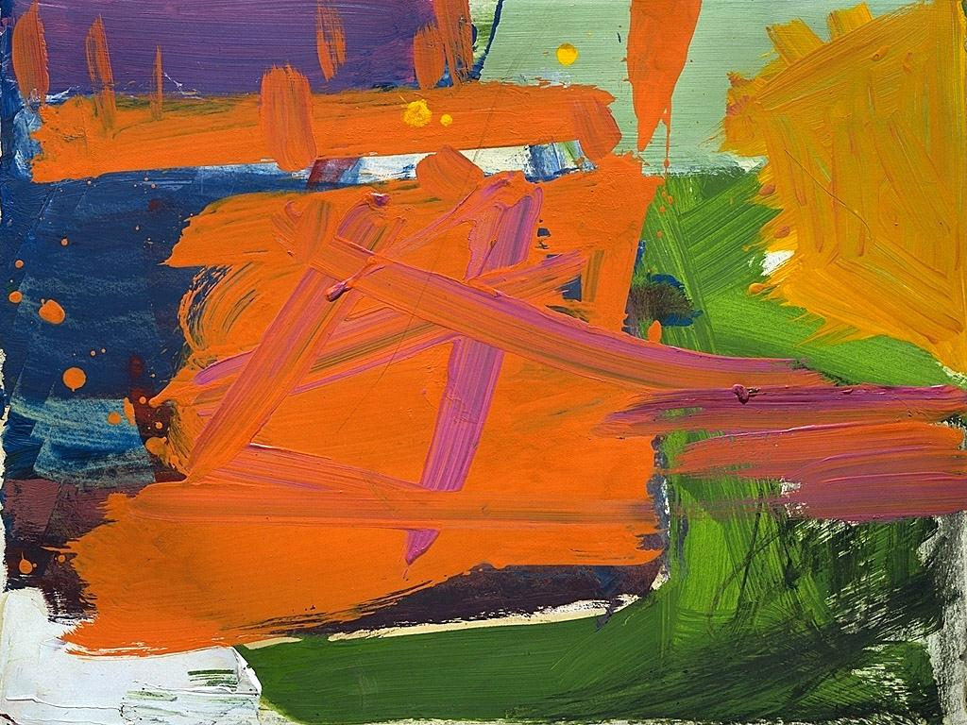
Franz Kline

Slide 45
Have a go at creating your own piece with a variety of examples of mark making. Can you reuse an item to make a different mark? What items could you use in your recycling bin to make prints?

Slide 46
Activity:
Create your own collection of different marks (this could just be on a piece of A4 paper.
Use any materials you have available (pencils, pens, paint) and see how you can change the way you hold them, or how you use them.
Are there any other things you could use to make marks? Maybe some beetroot could be used to make prints, or even an old tea bag?
I look forward to seeing what you all come up with!

