Slide 1
Easter Quiz 2020

Slide 2
Round 1
General knowledge

Slide 3
On what day is Easter Day celebrated?
What is five dozen?
A packet contains 1.5 kilograms of rabbit food. Jon feeds the Easter bunny 30 grams of food each day. How many days does the packet of food last?
Tesco is selling eggs for £1.79 each or £5.50 for 3. Which is better value ?
Sunday
60
50

Slide 4
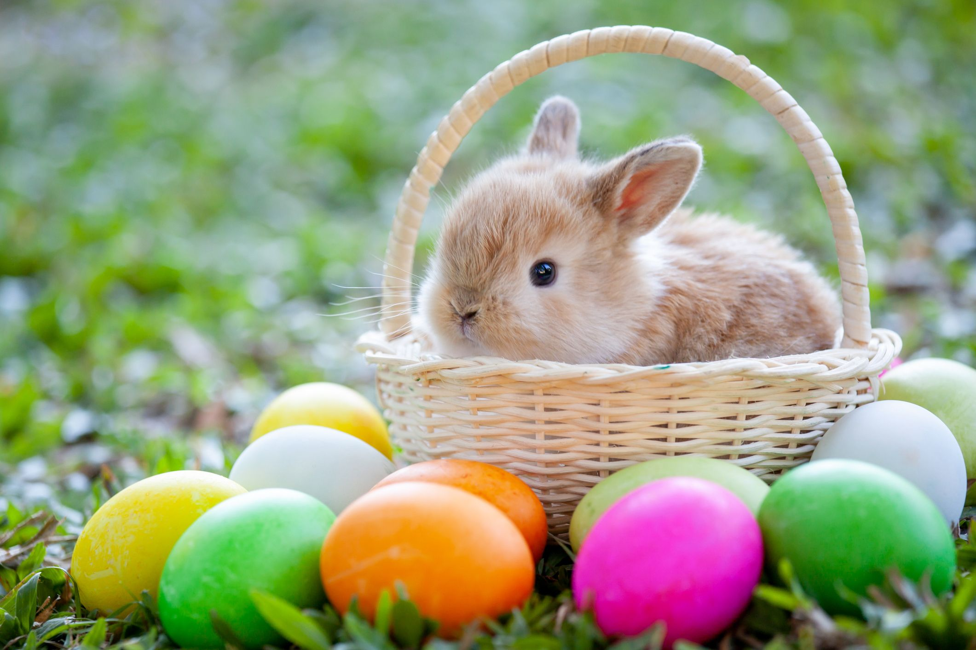

Slide 5
Round 2
Chocolate

Slide 6
Can you name the chocolate from the clues given ...
Big Bus
Spin around
Clever people
Sly giggle
Edible fasteners
A bit of lateral thinking...
Double decker
Twirl
Here’s an example:
Talk quietly
Smarties
Snicker
Chocolate buttons
WISPA

Slide 7

Round 3
Eggs

Slide 8
Harry has 12 Easter eggs. For every 3 he eats, he gives one to Dominic. How many Easter eggs does Harry give to Dominic?
What’s another name for the eggplant?
Which company produces `Crème eggs’?
There are 4 purple eggs in a basket. There are 13 times as many red eggs as purple eggs. What is the total number of eggs?
3
Aubergine
Cadburys
56

Slide 9
Round 4
Scrambled .. but not eggs

Slide 10
Unscramble the letters to spell a word associated with Easter
ACEHLOOTC
BNYNU
SGEG
ETSEAR
DYSANU
Chocolate
Bunny
Eggs
Easter
Sunday

Slide 11


