Slide 1
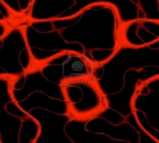

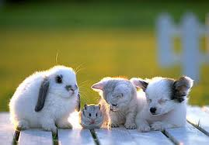


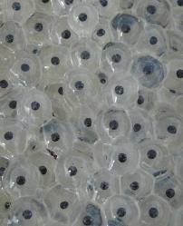
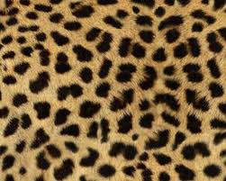
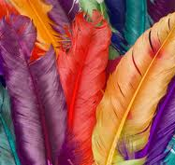
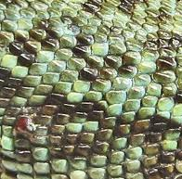
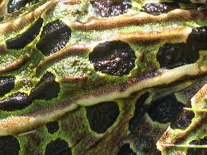
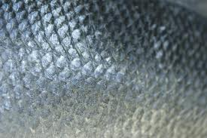
Comparing Groups of Vertebrates
Feature | Mammal | Bird | Reptile | Amphibian | Fish
Blood Offspring Skin Breathing
Warm
Warm
Cold
Cold
Cold
Born live
Eggs
Eggs
Eggs
Spawn
Spawn
Fur or hair
Feathers
Dry scales
Wet skin
Wet scales
Lungs and / or gills
Lungs
Lungs
Lungs
Gills

Slide 2
Date Compare the features of groups of vertebrates
What are the five groups that vertebrates can be classified as belonging to?
What are the two types of blood that vertebrates can have?
What 3 forms can the offspring of vertebrates be in?
What are the two types of breathing apparatus that vertebrates can have?
Are fish warm-blooded or cold-blooded?
Do reptiles have live young, lay eggs or lay spawn?
What sort of skin do amphibians have?
What breathing apparatus do birds have?
Which group of vertebrates may lay eggs or may lay spawn?
How many of the vertebrate groups have only lungs?
How many of the vertebrate groups have a wet type of skin?
Which two groups of vertebrates have scales?
Which two groups of vertebrates are warm-blooded?
Name one similarity between a mammal and a reptile.
Name one difference between mammals and birds.
Name two similarities between amphibians and fish.
Name two differences between reptiles and birds.
Do mammals have more in common with reptiles or with fish? Why? (use because)
Extension: Make up some of your own questions for a partner to answer.

Slide 3
Name: Date: Compare the features of groups of vertebrates
1) The five groups that vertebrates can be classified
as belonging to are
The two types of blood that vertebrates can have
are
3) The 3 forms of offspring that vertebrates can have
are
4) The two types of breathing apparatus that
vertebrates can have are
5) Fish are
6) Reptiles
7) Amphibians have
8) Birds have
9) may lay eggs or may lay
spawn.
10) of the vertebrate groups have only lungs.
11) of the vertebrate groups have a wet type
of skin.
12) have scales.
13) are warm-blooded.
14) One similarity between a mammal and a reptile is
15) One difference between mammals and birds is
16) Two similarities between amphibians and fish are
17) Two differences between reptiles and birds
18) Mammals have more in common with
because

Slide 4
Comparing Groups of Vertebrates
Feature | Mammal | Bird | Reptile | Amphibian | Fish
Blood Offspring Skin Breathing

